Slide 1



BOOTCAMP ONE | DAY THREE
HCD EXERCISE | DEFINE
ORGANISE & GENERATE INSIGHTS
Notes
Session Flow
Sharing the Objective | 2 Min
Facilitators to share the objective of the session/exercise.
Walkthrough - Example | 10 Min
Facilitators to walk through 1-2 examples of the tool in use.
Walkthrough - ‘How To?’ | 10 Min
Facilitators to walk through the ‘How to?’ of the tool as per instructions on the toolsheet.
Clarifications | 8 Min
Facilitators to clarify doubts from participants.
Exercise | 60 Min
Participants to use tool with guidance from the facilitation team. Since there are multiple tools to consider, a recommended flow could be -
Map Individual Learnings -5 Min
Affinity Mapping - 20 Min
Continue Affinity Map or do ERAF/Tree Diagram- 20 Min
Discuss Insights - 15 Min
Points to Consider
The numbering provided in the How To? is a recommended path. Startups may still choose to fill the template as per their convenience.
It may not be possible for a team to use all the tools (and they may not be necessary either). The team should choose what they feel is apt to process information collected.
All observations, quotations, learnings etc. that are top of mind/most memorable should be put out first by individuals on the team.
It is easy for people to jump to insights and be defensive about them - it is recommended that teams try and come to a consensus on insights together.
Research data (observations, quotations etc.) could be written on Post-Its to ease mapping. It can begin by each person writing their own findings (say top 10).
Photographs, films, sketches, objects can and should be used to support observations & user research.
Tools
Affinity Mapping, ERAF Diagram,
Tree Diagram
Material
Chart Paper, Post-Its, Pens/Sketch Pens
Time
90 Minutes
FINANCIAL INNOVATION LAB | BOOTCAMP ONE

Slide 2
INSIGHTING TOOLS: AFFINITY MAPPING, ERAF DIAGRAM, TREE DIAGRAM
Note: This is not a template but a representation of the tools.
ERAF Diagram
Affinity Mapping
Tree Diagram
Entities
Attributes
Relationships
Observations, Data, Quotes
Financial Flows
Key Takeaway / Insight
Affinities
Material Flows
Learnings, Observations
FINANCIAL INNOVATION LAB | BOOTCAMP ONE

Slide 3
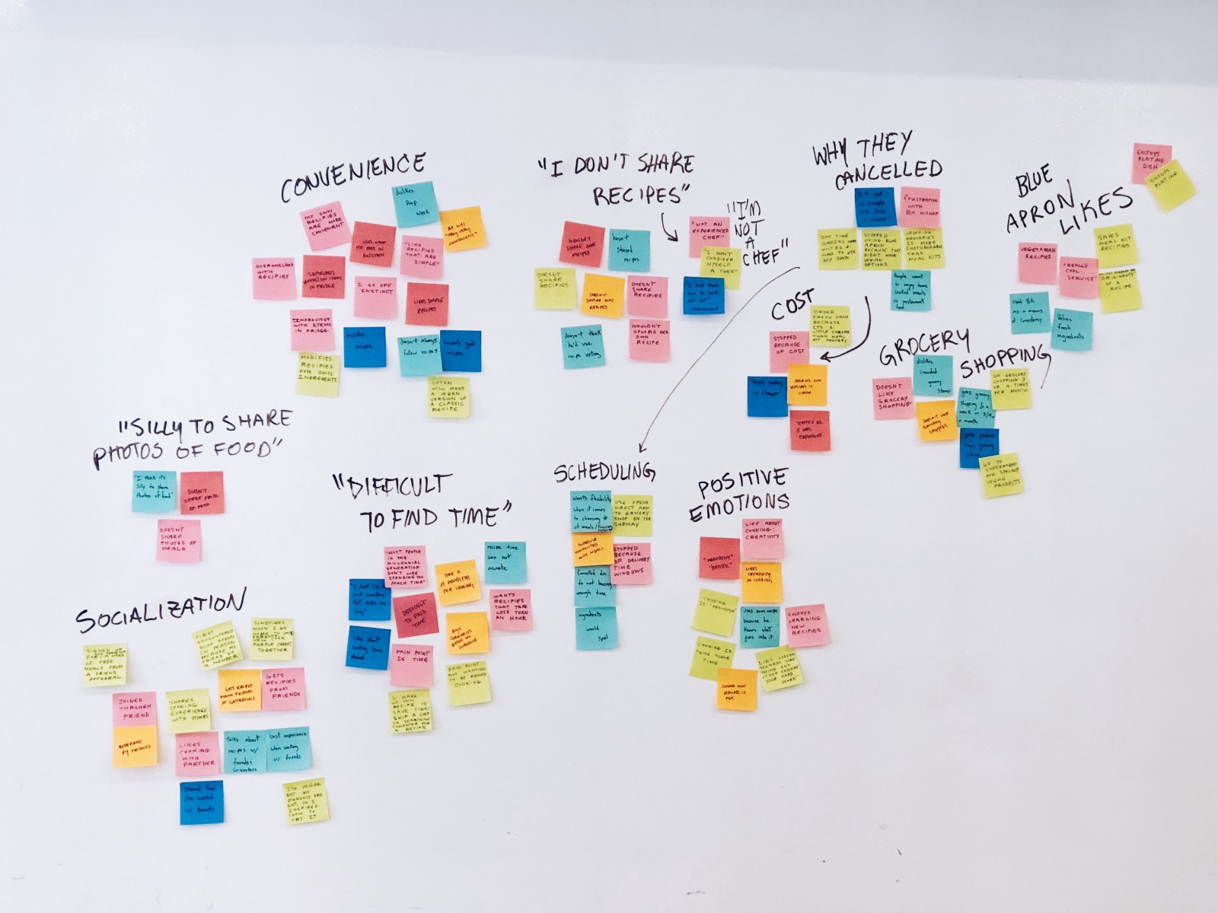
INSIGHTING TOOLS: AFFINITY MAPPING, ERAF DIAGRAM, TREE DIAGRAM
FINANCIAL INNOVATION LAB | BOOTCAMP ONE

Slide 4
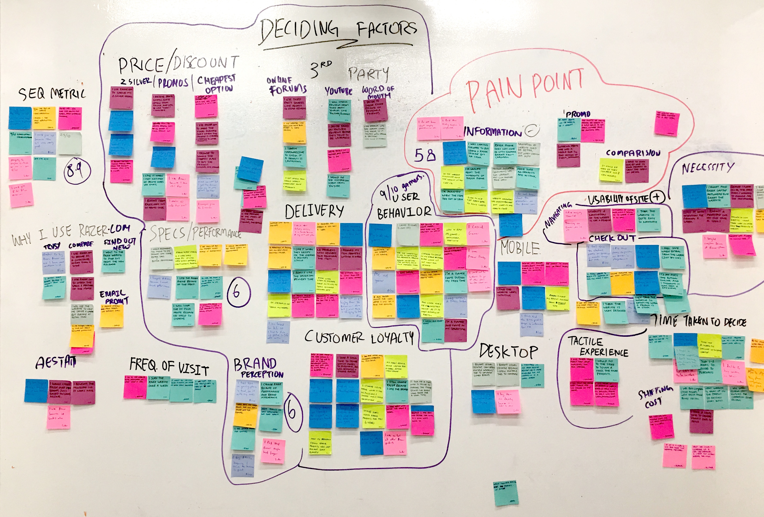
INSIGHTING TOOLS: AFFINITY MAPPING, ERAF DIAGRAM, TREE DIAGRAM
FINANCIAL INNOVATION LAB | BOOTCAMP ONE

